Slide 1

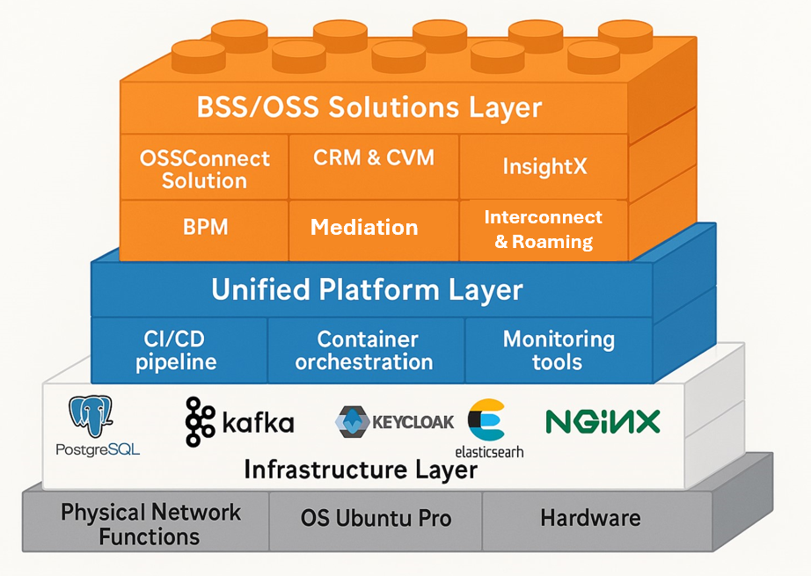

Are you AI Ready?
Offering an AI Transformed Comprehensive Telco OSS/BSS Ecosystem
BSSConnects reimagines your Network with Data & AI
Data Foundation
BSSConnects Mediation Solution
CDRs, xDRs, session/traffic events.
OSSConnects
KPIs, alarms, performance metrics
AI-Ready Vector Database
AI Transformation Pipeline
Normalization & enrichment
Embedding generation
Stored in vector DB (RAG-ready)
LLM-Powered Use Cases
Customer Experience: chatbots
Churn Prevention: risk scoring
Network Ops: anomaly detection
Monetization: dynamic pricing
IoT & 5G: predictive insights
The future of telecom is context-aware AI
Monetize intelligence, not just connectivity

