Slide 1
The First AI SaaS Monetization Platform

Slide 2
Centralized Platform For Mobile Payments and User Acquisition
MobiBox is the first AI-powered SaaS monetization platform for scalability designed to address the complexities of technical integration, traffic scalability, hosting, and ads compliance.

Slide 3
KEY PLAYERS
MobiBox operates with two innovative products, making it a comprehensive solution for businesses.
PAYMENT AS
A SERVICE
MOBILE OPERATORS
DCB AGGREGATORS
CONTENT PROVIDERS
PUBLISHERS
ADVERTISING AS
A SERVICE
APPS DEVELOPERS
Page 3

Slide 4
Presentation
PAYMENT AS A SERVICE:
What is PaaS?
Mobile Operator & DCB Aggregators
Advertiser
MobiBox PaaS enables businesses to manage their mobile payment subscriptions, host their content, offer alternative payment methods, and connect with payment providers to monetize their digital products and services effectively, thus enabling them to speed time to market and efficiently manage their monetization process.
Establish SDP DCB Platforms
Secure User Acquisition Flows
Control Marketing Funnels
Connect services with leading DCB providers
Accelerate time-to-market

Slide 5
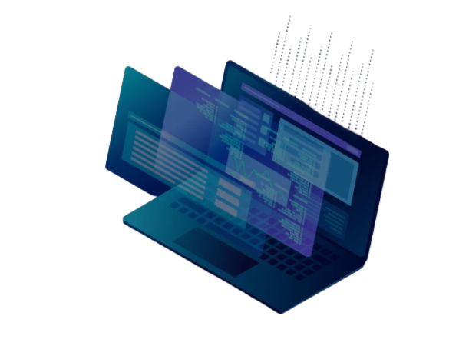
PAYMENT AS A SERVICE
PAYMENT AS A SERVICE
FEATURES
SDP Setup
API/S2S Integration
Anomaly Detection
Services Management
Compliance Monitoring
Checkout Page Builder
INTEGRATIONS
DCB Aggregators API Worldwide
Revenue Sharing DCB Services Marketplace
Ticketing System
Fraud Prevention
BI
Analytics

Slide 6
Presentation
ADVERTISING AS A SERVICE:
What is ADaaS?
Mobile Operator
Advertiser
Looking to oversee, control, and enhance advertisers’ marketing compliance.
Looking to monetize services through marketing optimization.
MobiBox Advertising as a Service allows publishers, affiliates and social media agencies to launch marketing campaigns effectively, leverage credit-based accounts for social media agencies, access Mobibox marketplace for direct DCB offers marketplace, and tracking and analytical tools.
Publishers
Looking to manage large-scale campaigns on a single platform.

Slide 7
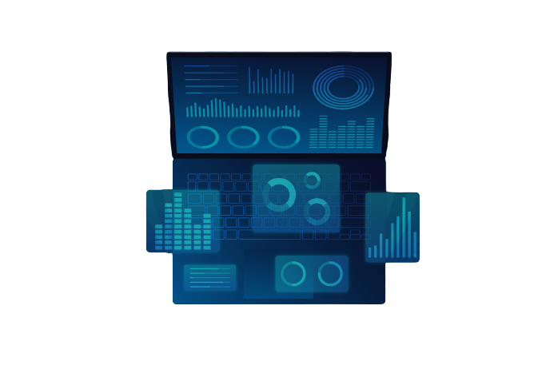
ADVERTISING AS A SERVICE
FEATURES
Advanced Tracking
Funnel
Creation
Smartlinks
Management
Reporting Analytics
ROI
Management
INTEGRATIONS
Google, Facebook, TikTok & DSPs
DCB Offers & Apps
Marketplace
Traffic Anomaly Detection
Ads
Automation
BI Integration

Slide 8
OUR AI POWERED TECHNOLOGY
ANOMALY DETECTION BY MACHINE LEARNING
AI-BASED CAMPAIGNS MANAGEMENT
AI-BASED SMARTLINK ROTATION
Page 8

Slide 9
OUR BUSINESS TOOLS
MobiBox data is seamlessly integrated with leading business intelligence tools such as Quicksight, Power BI, and Tableau providing robust capabilities to measure and analyze ROI effectively.
Page 9

Slide 10
STRATEGIC BUSINESS
PARTNERSHIPS & COLLABORATIONS
TRAFFIC: GOOGLE, FACEBOOK, TIKTOK
ANTI-FRAUD: EVINA, MCP, EMPELLO, AWS FRAUD DETECTOR
HOSTING: AWS

Slide 11
JOIN OUR MOBIBOX COMMUNITY
Office Location
Website & Email
Beirut, Lebanon
Dubai, UAE
Berlin Germany
Vapi, India
Mobibox.mobi
bdev@mobileartsme.com
Page 11

